Slide 1
Decision Making in Open Agent Systems
AAMAS 2025 Tutorial
Detroit, Michigan, USA
May 19, 2025

Slide 2
Acknowledgement
This research was supported by a collaborative grant from the National Science Foundation: #IIS-2312657 (to P.D.), #IIS-2312658 (to L.K.S.), and #IIS-2312659 (to A.E.)
This work also used the Holland Computing Center of the University of Nebraska and received support from the UNL Office of Research and Economic Development and the Nebraska Research Initiative.
We thank the following students for contributing to the development of OASYS:
Muthukumaran Chandrasekaran, Maulik Shah, Anirudh Kakarlapudi, Keyang He, Gayathri Anil, Bala Duggirala, Ceferino Patino, Alireza Saleh Abadi, Tyler Billings, Daniel Firebanks-Quevedo, Quinn Barker-Plummer, Tumas Rackaitis, Gaurab Pokharel, Ran Liu, Tianxing Zhu, Zejian Huang, Dung Do, Kenean Yemane Kejela, Quan Nguyen, Ryn Lazorchak, Menard Simoya, and M. Daud Zarif.
Any opinions, findings, and conclusions or recommendations expressed in this material are those of the author(s) and do not necessarily reflect the views of the National Science Foundation.
Notes:
8:35 AM: Topic 1 (45 minutes)
9:20 AM: Stretch Break (10 minutes)
9:30 AM: Topic 2 (30 minutes)
10:00 AM: 45 minute coffee break
10:45 AM: Topic 2 continues (20 minutes)
11:05 AM: Topic 3 (45 minutes)
11:50 AM: 10 minute break
12:00 PM: Topic 4 (20 minutes)

Slide 3
Definition of Openness
Open systems are dynamic environments where agents, tasks, and capabilities can change over time
Open systems must handle unexpected changes in the environment
Multiple agents (possibly of different types) that interact in a shared space
Models must accommodate new agents and tasks appearing or disappearing unexpectedly

Slide 4
Importance
Much better representation for real-world scenarios
Robots should be able to adapt to new roles during a mission
Firefighters should be able to adapt to other units joining and leaving the effort
Team members should be able to adapt to the overall goals of the team changing
Common in applications such as emergency response, collaborative robotics, and smart grids

Slide 5
Tutorial Motivation
Explore challenging environmental complexities causing uncertainty in real-world applications
Discuss state-of-the-art solutions to decision making in which the sets of agents, tasks, and/or capabilities change over time
Consider emerging avenues of future research for enhancing decision-making in critical domains

Slide 6
Introductions
Leen-Kiat Soh is the Charles Bessey Professor and Senior Associate Director of the School of Computing at the University of Nebraska. His research interests include multiagent systems, modeling, and simulation, in addition to computer science education and intelligent data analytics.
Adam Eck is the David H. and Margaret W. Barker Associate Professor of Computer Science & Business and Chair of Data Science at Oberlin College. His research interests include multiagent decision making in complex environments, as well as interdisciplinary applications of machine learning.

Slide 7
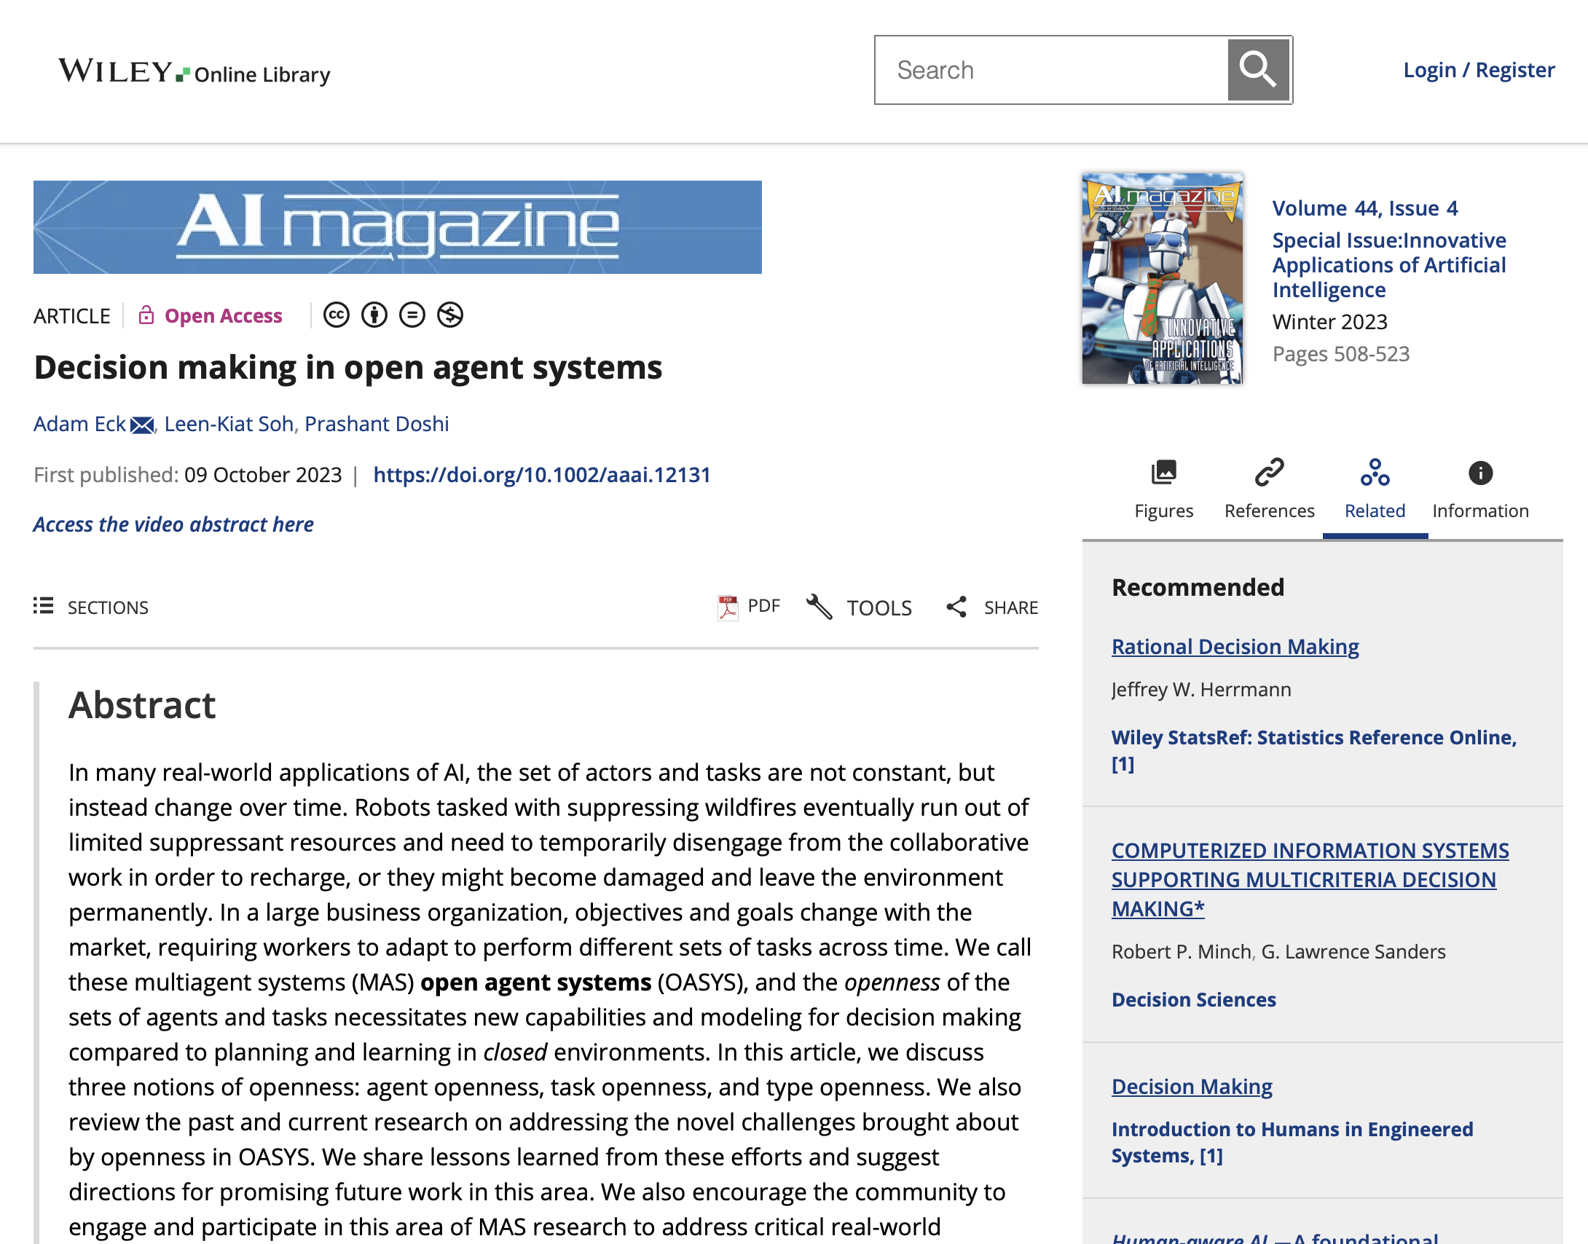
Survey Paper
A. Eck, L-K. Soh, & P. Doshi. 2023. Decision making in open agent systems. AI Magazine. 44(4): 508-523.

Slide 8
Outline
Topic 1: Introduction to Open Agent Systems [45 min]
Types and Sources of Openness
Challenges caused by Openness
Example Applications
Topic 2: Multiagent Reasoning in OASYS [50 min]
Origins of OASYS
Background: (Multiagent) Markov Decision Processes
Planning and Reinforcement Learning Solutions
Topic 3: Emerging and Future Research in OASYS [45 min]
Addressing scalability to many-agent systems
Focusing on Task and Type Openness
Human-AI Interactions
Topic 4: MOASEI Competition and Community Discussion [20 min]
Notes:
8:35 AM: Topic 1 (45 minutes)
9:20 AM: Stretch Break (10 minutes)
9:30 AM: Topic 2 (30 minutes)
10:00 AM: 45 minute coffee break
10:45 AM: Topic 2 continues (20 minutes)
11:05 AM: Topic 3 (45 minutes)
11:50 AM: 10 minute break
12:00 PM: Topic 4 (20 minutes)

Slide 9
Outline
Topic 1: Introduction to Open Agent Systems [45 min]
Types and Sources of Openness
Challenges caused by Openness
Example Applications
Topic 2: Multiagent Reasoning in OASYS [50 min]
Origins of OASYS
Background: (Multiagent) Markov Decision Processes
Planning and Reinforcement Learning Solutions
Topic 3: Emerging and Future Research in OASYS [45 min]
Addressing scalability to many-agent systems
Focusing on Task and Type Openness
Human-AI Interactions
Topic 4: MOASEI Competition and Community Discussion [20 min]

Slide 10
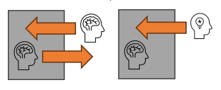
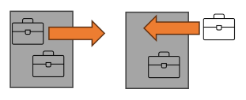
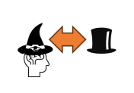
Types of Openness
Agent Openness
agents can dynamically enter or leave the environment
Task Openness
tasks can appear or disappear, requiring flexible strategies
Type Openness
agent capabilities and roles can evolve or change over time

Slide 11
Agent Openness
Agents can dynamically enter or leave the environment
Firefighters can leave the environment to take rest or refill suppressant, then rejoin when they are ready
Attackers in a cybersecurity setting can disappear to rejoin an attack at a different node
Drivers in a rideshare organization can leave to refuel or retire for the day

Slide 12
Challenges of Agent Openness
Temporary agent openness: agents must first predict who is still around before deciding a best response
E.g., which firefighting robots have suppressant and can help me fight neighboring fires?
Permanent agent openness: agents must react to new peers joining and existing peers leaving forever
E.g., what trusted peers will be leaving before my task is completed?
What new competition might I face in the future?

Slide 13
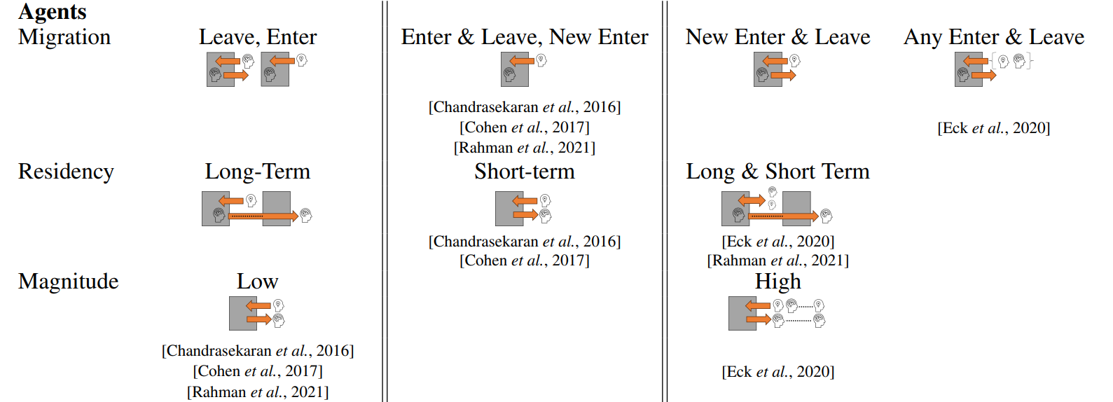
Manifestations of Agent Openness
Agent Migration - Whether agents can enter and leave the environment, and whether new agents can enter while old agents leave
Residency - The length of an agent’s stay in the environment and the frequency of leaving / re-entering
Magnitude - The number of agents that can enter and leave the environment at any given time

Slide 14
Task Openness
Tasks can appear or disappear, requiring flexible strategies
New fires can appear, old ones can be completely put out
New passengers can appear, while others can be picked up by other drivers
The goals of different teams in an organization may change over time
Source can be endogeneous (predictable) or exogeneous (unpredictable)

Slide 15
Challenges of Task Openness
Existing tasks can disappear before completed
Will I have time to get to this task before it is gone?
Am I wasting resources and time on something I cannot complete
New tasks can appear during execution
How can I know that my current task is worth the resource expenditure when something new can appear at any moment?
How to achieve non-myopic reasoning when tasks are unpredictable?

Slide 16
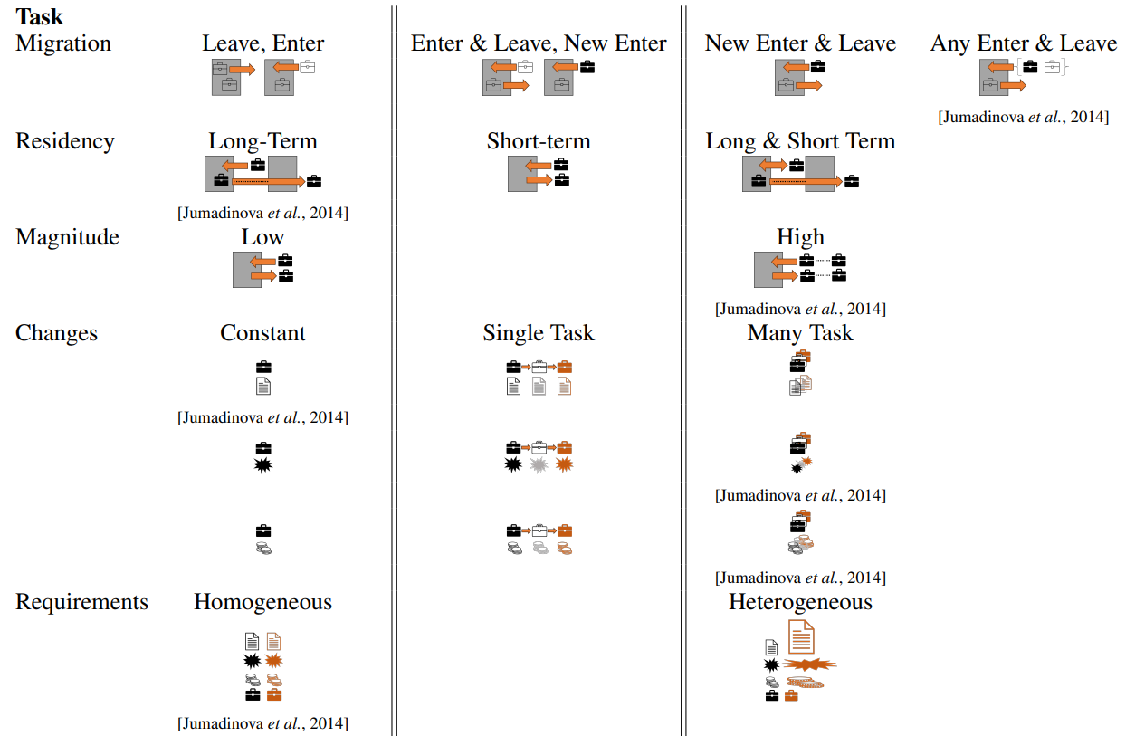
Manifestations of Task Openness
Migration – Whether tasks can change, enter, and/or leave
Residency – The length of a task remaining in the environment
Magnitude – The # of tasks that can change in the environment at any given time
Changes – Whether the properties of the task itself changes (requirements, reward / transition functions)
Requirements – Whether the requirements of a task require a specific skill or type of agent

Slide 17
Type Openness
Agent capabilities and roles can evolve or change over time
Employees in an organization can be promoted to new roles with additional skills
Robots become degraded during execution due to environmental effects

Slide 18
Challenges of Type Openness
Affects what tasks an agent might want to take on or which peers they want to interact with
Causes localized agent and task openness within the type-changed agent’s neighborhood
Can require replanning or updating learning of the agent’s own plans and the plans of its neighbors
How to achieve without pausing execution?
How do we model agents with evolving types?

Slide 19
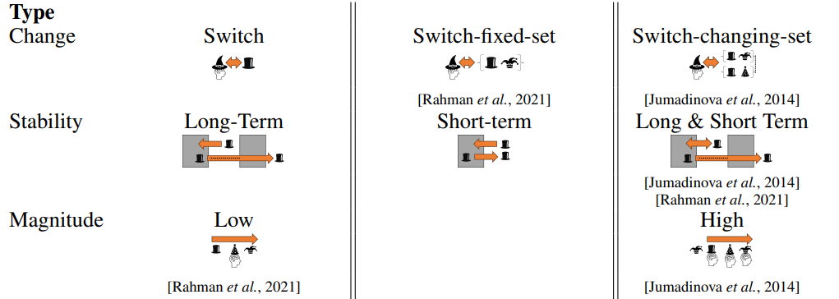
Manifestations of Type Openness
Changes – Changes in the set of skills, whether swapped with another agent, or chosen from a set of types
Stability – The frequency of changes to an agent’s type
Magnitude – The magnitude of changes to all agent types in the environment

Slide 20
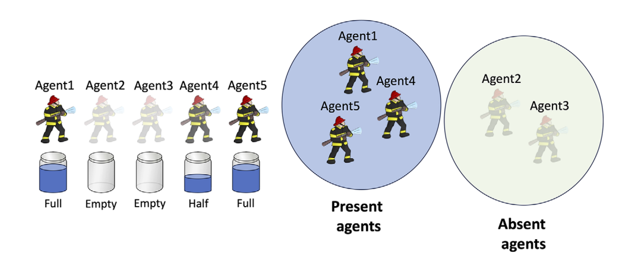
Implications of Openness
Agents now must model
The degree or level of openness
Changing sets of agents and / or tasks
Representations of the boundaries of uncertain knowledge

Slide 21
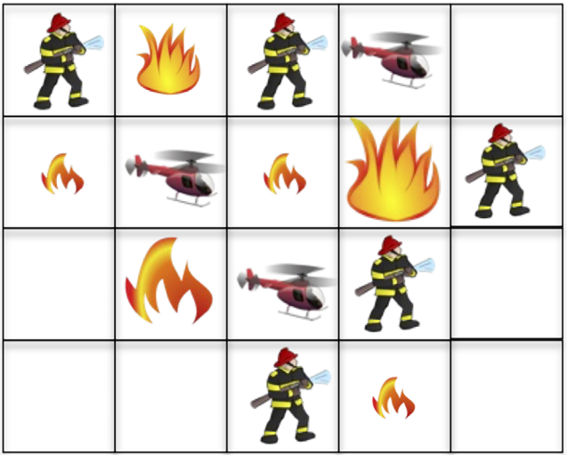
Wildfire Suppression
Wildfire suppressing agents operate in an open environment where agents use limited suppressant resources to collaboratively put out fires and periodically leave the system to recharge their suppressants.

Slide 22
Openness in Wildfire Suppression
Agent Openness: agents can leave to recharge their suppressant
Agents are in complete control of whether they leave or remain in the environment
An agent with suppressant can choose to take a noop action to wait for a cooperator to return
An agent without suppressant can still choose to fight a fire (even with a heavy penalty)
Agents need to maintain a belief of the presence of each of the other agents before fighting cooperative fires
Task Openness: new fires can be created and must be put out; old fires can burn out

Slide 23
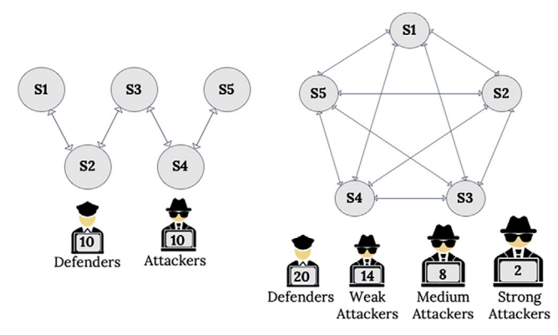
Cybersecurity Defense
Network cyberdefense agents operate in environments where a stochastic set of attackers frequently launch attacks on subnets in a computer network then disappear to infect the subnet and avoid detection.

Slide 24
Openness in Cybersecurity Defense
Agent Openness: agents are randomly pulled out of the environment; attackers can leave and attack vulnerable nodes elsewhere
Attackers can leave and reappear elsewhere
Defenders can be taken offline and be unable to navigate to certain nodes
Type Openness: defenders gain new privileges and can perform more complicated defense operations

Slide 25
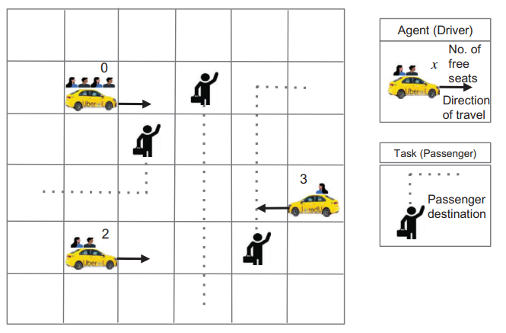
Autonomous Rideshare
Autonomous cars (driver agents) operate in a city to service human passengers (tasks), competing for fares while cooperating to make sure all passengers reach their destinations

Slide 26
Openness in Autonomous Rideshare
Agent Openness: cars temporarily leave the system to refuel (gas or battery charge) or because their owner needs to use the car for their own transportation
Task Openness: new passengers enter the environment dynamically both predictably (e.g., after work, after entertainment events) and unpredictably (e.g., needing a sudden ride)

Slide 27
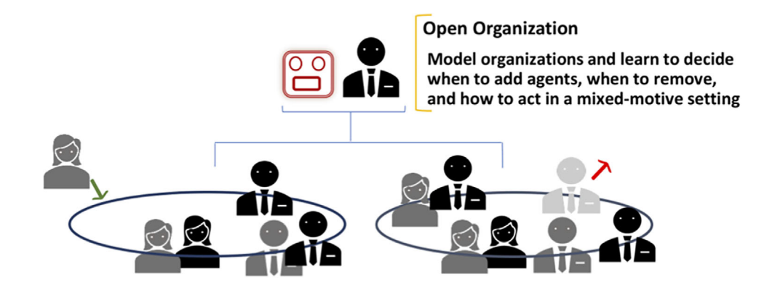
Business Organization
The organization domain models its decision making in a typical business organization featuring a mix of cooperation towards overall benefit and competition for a shared bonus pool.
Notes:
Image source: He, K., Doshi, P., & Banerjee, B. (2024). Modeling and reinforcement learning in partially observable many-agent systems. Autonomous Agents and Multi-Agent Systems, 38(1). https://doi.org/10.1007/s10458-024-09640-1

Slide 28
Openness in Business Organization
Agent Openness: agents can be hired and fired; or quit
Internal agents fully control the system openness
Agents can leave for retirement or job-hopping
Agents can be forced to leave
New agents are hired to fill job vacancies
Task Openness: the objectives of the company change over time, resulting in new products being created and old products being discontinued
Type Openness: workers move between teams, changing roles in the organization; individuals are promoted and gain new responsibilities and capabilities

Slide 29


Compare and Contrast
Domain | Agent Relationships | Agent Openness | Task Openness | Type Openness
Wildfire Suppression | Cooperative
Cybersecurity Defense | Mixed
Autonomous Rideshare | Competitive
Business Organization | Mixed

Slide 30
Exercise 1: Part 1
As a group, identify and describe a real-world domain:
What/who are the agents?
What are the tasks?
What are the decisions/actions that the agents have to make?

Slide 31
Exercise 1: Part 2
Discuss the types of openness that might manifest in the domain:
Is there agent openness in the domain?
Is there task openness in the domain?
Is there type openness in the domain?

Slide 32
Exercise 1: Part 3
Switch domains with another group, review their domain and openness, and identify if there are other ways that openness might manifest in that domain.

Slide 33
Challenges in Open Environments
Increased uncertainty
Unpredictability in future states and decisions
Less certainty in transition probabilities due to the presence / absence of agents
Systems must be robust against these uncertainties to make reliable decisions
Computational complexity
Dynamism increases reasoning and planning complexity
Reasoning challenges
Predicting actions of new agents that are dynamic creates problems in accurate modeling

Slide 34
Opportunities in Open Environments
Potential for systems to become more adaptive and resilient
Systems can adjust to new agents and still perform tasks in dynamic settings
Development of solutions to dynamic challenges
Potential for efficient management of large numbers of more specialized agents to perform tasks

Slide 35
Intermission
10 minute break

Slide 36
Outline
Topic 1: Introduction to Open Agent Systems [45 min]
Types and Sources of Openness
Challenges caused by Openness
Example Applications
Topic 2: Multiagent Reasoning in OASYS [50 min]
Origins of OASYS
Background: (Multiagent) Markov Decision Processes
Planning and Reinforcement Learning Solutions
Topic 3: Emerging and Future Research in OASYS [45 min]
Addressing scalability to many-agent systems
Focusing on Task and Type Openness
Human-AI Interactions
Topic 4: MOASEI Competition and Community Discussion [20 min]

Slide 37
Origins of Open Agent Systems
Software Infrastructure
Shehory (2000): defined openness as agents joining and leaving the system, often in dynamic ways without global notification
Calmet (2004): open society allows new agents to join without definite goals
Jamroga, Meski, & Szreter (2013): degree of openness is the complexity of minimal changes needed to add or remove an agent from the system

Slide 38
Origins of Open Agent Systems
Trust and Reputation Systems
Huynh, Jennings, & Shadbolt (2006): study how to model trust in open MAS where the set of agents change over time
Pinoyl & Sabater-Mir (2011): how to control interactions between agents to find trustworthy partners in open systems where agents come and go

Slide 39
Origins of Open Agent Systems
Decision Making
Jumadinova et al. (2014): modeled the rates at which agents and tasks join and leave the environment when deciding which tasks to bid on in a contract-net protocol
Chen et al. (2015): considered agent and task openness in ad hoc environments (Stone et al., 2010) where agents must interact with others with no opportunity for prior coordination or communication
Chen, Eck, & Soh (2016): extended agent and task openness to human collaborative task assignment for supporting the gig economy

Slide 40
Markov Decision Processes
Sensing/Rewards
Environment
Agent
Actions

Slide 41
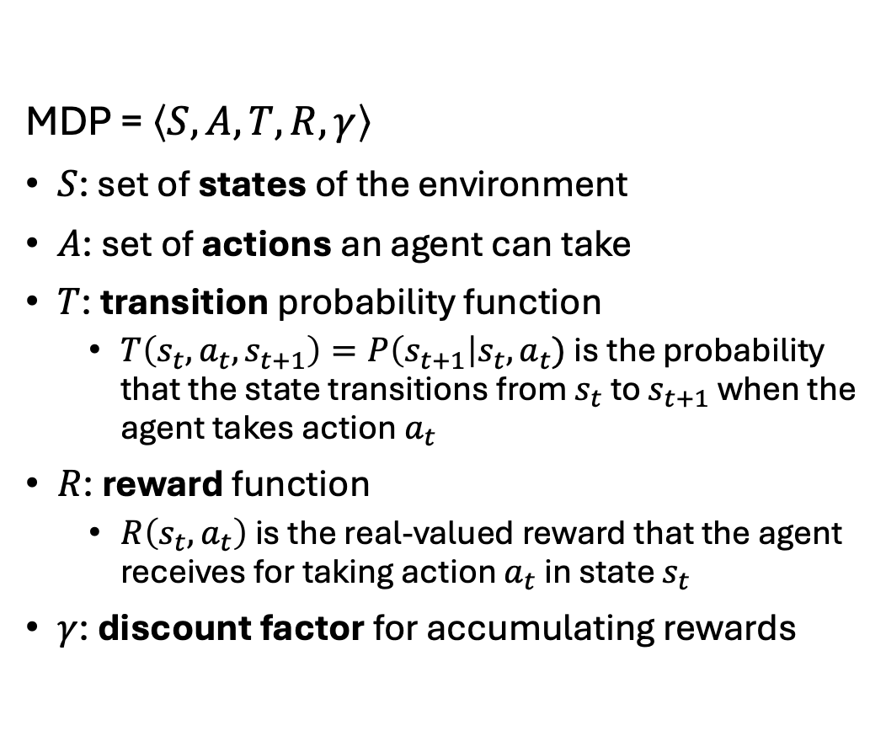
Markov Decision Processes
MDP = $\left\langle S, A, T, R, γ\right\rangle$
$S$: set of states of the environment
$A$: set of actions an agent can take
$T$: transition probability function
$T\left(s_{t}, a_{t}, s_{t+1}\right)=P\left(s_{t+1}\right|s_{t}, a_{t})$ is the probability that the state transitions from $s_{t}$ to $s_{t+1}$ when the agent takes action $a_{t}$
$R$: reward function
$R\left(s_{t}, a_{t}\right)$ is the real-valued reward that the agent receives for taking action $a_{t}$ in state $s_{t}$
$γ$: discount factor for accumulating rewards

Slide 42
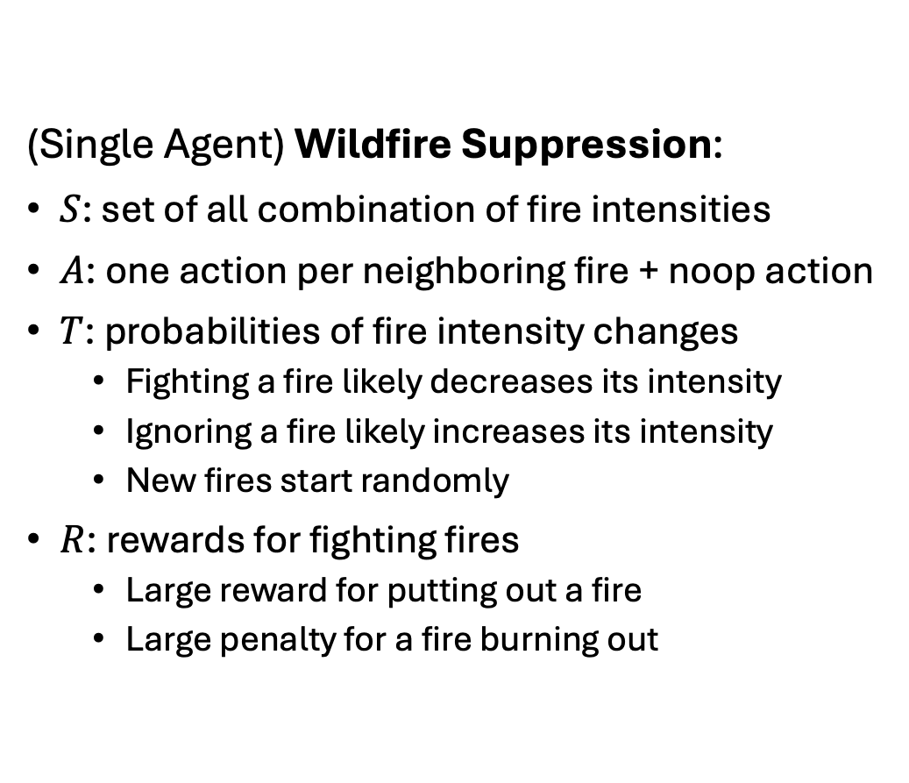
Markov Decision Processes
(Single Agent) Wildfire Suppression:
$S$: set of all combination of fire intensities
$A$: one action per neighboring fire + noop action
$T$: probabilities of fire intensity changes
Fighting a fire likely decreases its intensity
Ignoring a fire likely increases its intensity
New fires start randomly
$R$: rewards for fighting fires
Large reward for putting out a fire
Large penalty for a fire burning out

Slide 43
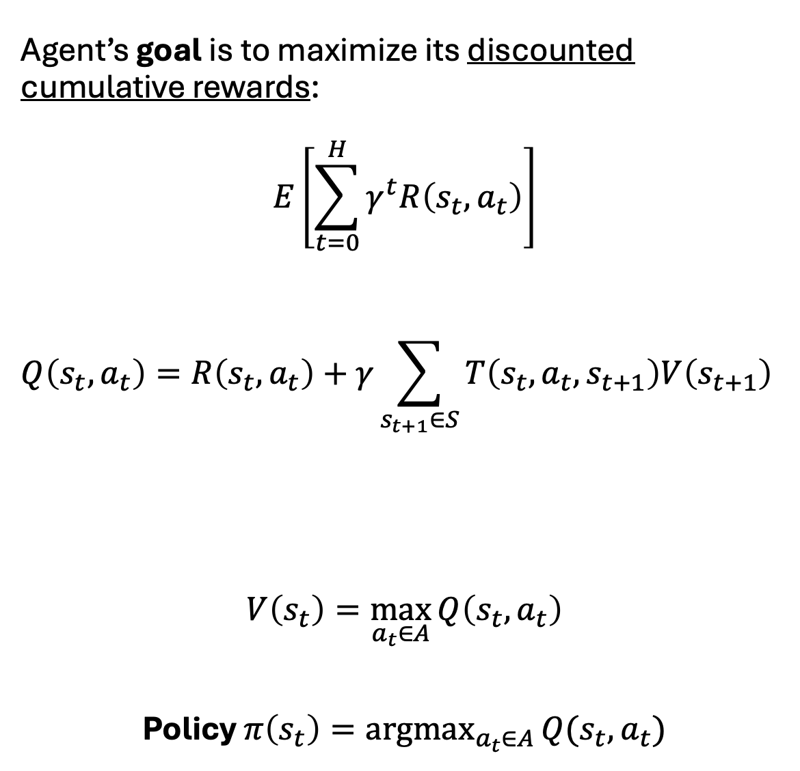
Bellman Equations
Agent’s goal is to maximize its discounted cumulative rewards:
$$E\left[\sum_{t=0}^{H}{γ^{t}R\left(s_{t}, a_{t}\right)}\right]$$
$$Q\left(s_{t}, a_{t}\right)=R\left(s_{t}, a_{t}\right)+γ\sum_{s_{t+1}∈S}{T\left(s_{t}, a_{t}, s_{t+1}\right)V\left(s_{t+1}\right)}$$
$$V\left(s_{t}\right)=\max_{a_{t}∈A}{Q\left(s_{t}, a_{t}\right)}$$
Policy $π\left(s_{t}\right)=\underset{a_{t}∈A}{argmax}{Q(s_{t}, a_{t})}$
Immediate Reward
(Uncertain) Future Rewards

Slide 44
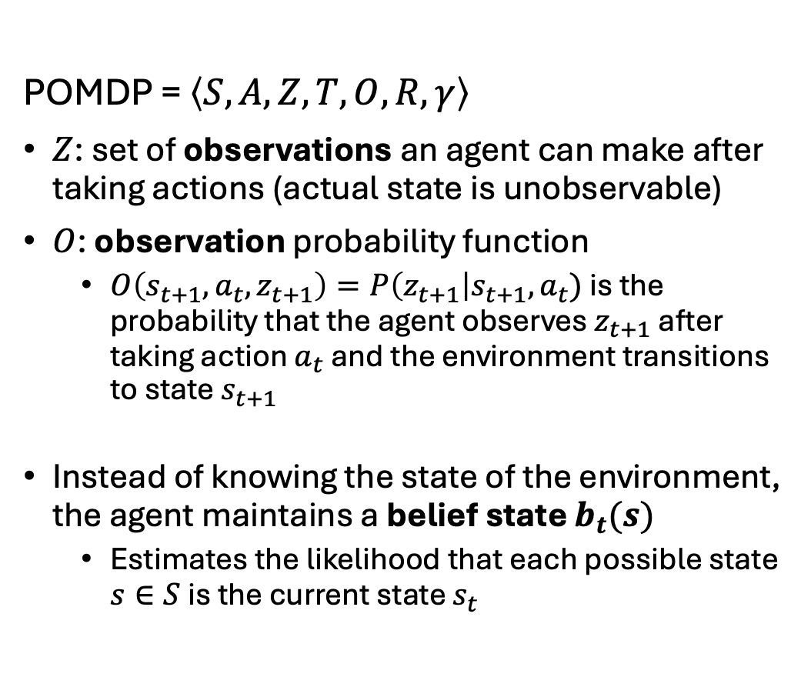
Partially Observable Markov Decision Processes
POMDP = $\left\langle S, A, Z, T, O, R, γ\right\rangle$
$Z$: set of observations an agent can make after taking actions (actual state is unobservable)
$O$: observation probability function
$O\left(s_{t+1}, a_{t}, z_{t+1}\right)=P\left(z_{t+1}\right|s_{t+1}, a_{t})$ is the probability that the agent observes $z_{t+1}$ after taking action $a_{t}$ and the environment transitions to state $s_{t+1}$
Instead of knowing the state of the environment, the agent maintains a belief state $b_{t}(s)$
Estimates the likelihood that each possible state $s∈S$ is the current state $s_{t}$

Slide 45
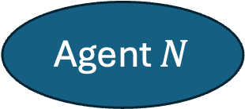
Markov Games
Agent 1
Agent 2
Environment
…
Agent $N$

Slide 46
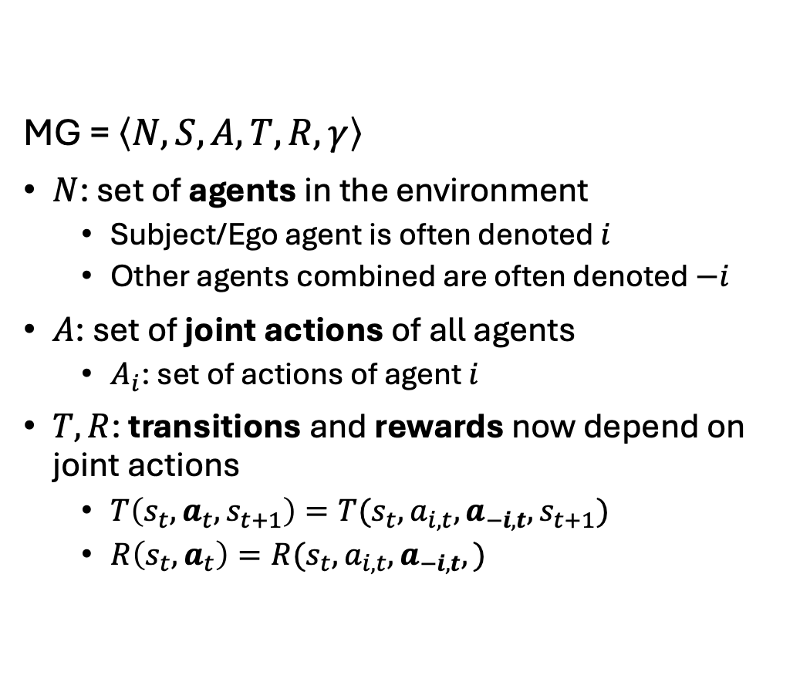
Markov Games
MG = $\left\langle N, S, A, T, R, γ\right\rangle$
$N$: set of agents in the environment
Subject/Ego agent is often denoted $i$
Other agents combined are often denoted $−i$
$A$: set of joint actions of all agents
$A_{i}$: set of actions of agent $i$
$T, R$: transitions and rewards now depend on joint actions
$T\left(s_{t}, a_{t}, s_{t+1}\right)=T(s_{t}, a_{i,t}, a_{−i,t}, s_{t+1})$
$R\left(s_{t}, a_{t}\right)=R(s_{t}, a_{i,t}, a_{−i,t},)$

Slide 47
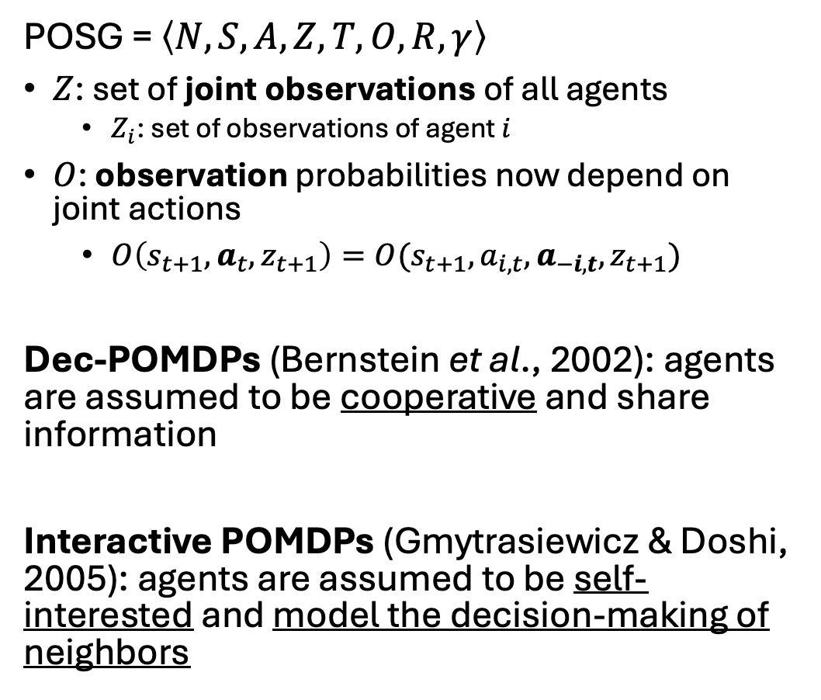
Partially Observable Stochastic Games
POSG = $\left\langle N, S, A, Z, T, O, R, γ\right\rangle$
$Z$: set of joint observations of all agents
$Z_{i}$: set of observations of agent $i$
$O$: observation probabilities now depend on joint actions
$O\left(s_{t+1}, a_{t}, z_{t+1}\right)=O(s_{t+1}, a_{i,t}, a_{−i,t}, z_{t+1})$
Dec-POMDPs (Bernstein et al., 2002): agents are assumed to be cooperative and share information
Interactive POMDPs (Gmytrasiewicz & Doshi, 2005): agents are assumed to be self-interested and model the decision-making of neighbors

Slide 48
Exercise 2: Part 1
As a group, think about Wildfire Suppression:
How would we model it as a POSG?
What are the states, actions, observations, etc.?

Slide 49
Exercise 2: Part 2
As a group, think about your earlier real-world domain:
How would we model it as a POSG?
What are the states, actions, observations, etc.?

Slide 50
Modeling Agent Openness (Presence States)
Chandrasekaran et al. (2016): added presence states to track the presence of each agent in the environment
Addresses temporary agent openness where the total set of agents is fixed but the operating set of agents changes over time

Slide 51



Intermission
45 minute coffee break

Slide 52
Outline
Topic 1: Introduction to Open Agent Systems [45 min]
Types and Sources of Openness
Challenges caused by Openness
Example Applications
Topic 2: Multiagent Reasoning in OASYS [50 min]
Origins of OASYS
Background: (Multiagent) Markov Decision Processes
Planning and Reinforcement Learning Solutions
Topic 3: Emerging and Future Research in OASYS [45 min]
Addressing scalability to many-agent systems
Focusing on Task and Type Openness
Human-AI Interactions
Topic 4: MOASEI Competition and Community Discussion [20 min]

Slide 53
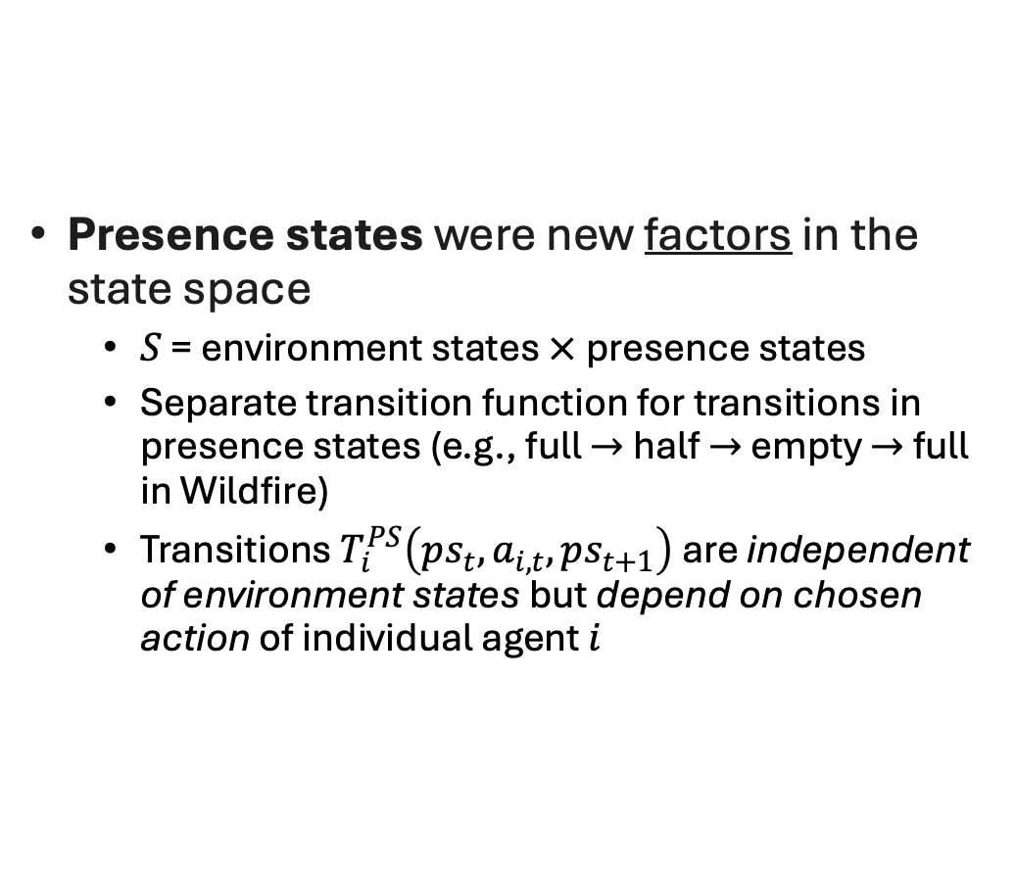
Modeling Agent Openness (Presence States)
Presence states were new factors in the state space
$S$ = environment states $×$ presence states
Separate transition function for transitions in presence states (e.g., full $→$ half $→$ empty $→$ full in Wildfire)
Transitions $T_{i}^{PS}\left(ps_{t}, a_{i,t}, ps_{t+1}\right)$are independent of environment states but depend on chosen action of individual agent $i$

Slide 54
Modeling Agent Openness (Presence States)
Developed an offline planning algorithm (I-PBVI) for creating policies of how to act in open environments
Extended Point-based Value Iteration (PBVI; Pineau, Gordon, & Thrun, 2003) to multiagent planning in I-POMDP Lite (Hoang & Low, 2012) with agent openness
Agents form beliefs about the current presence of other agents and react as their presence changes

Slide 55
Modeling Agent Openness (Presence States)
Also used model-based RL for learning presence state transitions
Extended Bayes Adaptive POMDPs (Ross, Chaib-draa, & Pineau, 2007) to multiagent learning with agent openness
Model trained using a simulator, then use online planning with Monte Carlo Tree Search (MCTS) methods
Agents can predict changes in future presence of neighbors and determine appropriate actions to maximize long-term rewards

Slide 56
Modeling Agent Openness (Coalitions)
Cohen, Dibangoye, & Mouaddib (2017): added coalitions to track the presence of each agent in the environment
Also addresses temporary agent openness where the total set of agents is fixed but the operating set of agents changes over time

Slide 57
Modeling Agent Openness (Coalitions)
Coalitions of agents (e.g., absent vs. present) transition over time
Can be controlled (endogeneous) or uncontrolled (exogeneous)
Agents in a coalition share observations and rewards (Dec-POMDP)
Simplifies the problem under agent openness because only need to consider agents in the present coalition

Slide 58
Modeling Agent Openness (Coalitions)
Developed an offline planning algorithm based on a combination of MCTS and Best Response Dynamics (BRD)
Iteratively selects the best response for one agent at a time using tree-based MCTS planning
Prioritizes agents expected to be the environment longer (largest impact on others)
Can achieve a Nash Equilibria (if one exists)
Agents have no incentive to deviate from their policies, so never have to recompute policy

Slide 59
Modeling Agent Openness (Scalability)
Eck et al. (2020) address two key challenges in agent openness:
How to model larger systems with many agents?
Presence states and coalitions are difficult to scale due to combinatorial explosion
How to make decisions in real-time when the number of environment states is large?
Curse of history and curse of dimensionality

Slide 60
Modeling Agent Openness (Scalability)
Selectively modeled only a few neighbors, then extrapolating their presence and behaviors
Utilize techniques from polling and survey literature to estimate large populations from only a few individuals
Addresses scalability of number of agents in the system

Slide 61
Modeling Agent Openness (Scalability)
Developed an online planning algorithm (I-POMCP)
Extended the POMCP algorithm (Silver & Veness, 2010) to multiagent planning with agent openness
Agents decide actions in real-time from only its current belief instead of needing to pre-plan for all possible beliefs
Addresses scalability of environment model size

Slide 62
Modeling Agent Openness (Scalability)
Theoretical results established error bounds on:
Proportions of neighbors choosing each action
Logarithmic in the total number of agents
Likelihoods of overall behaviors of neighbors
Estimations of cumulative rewards (regret)
Polynomial in the total number of agents

Slide 63
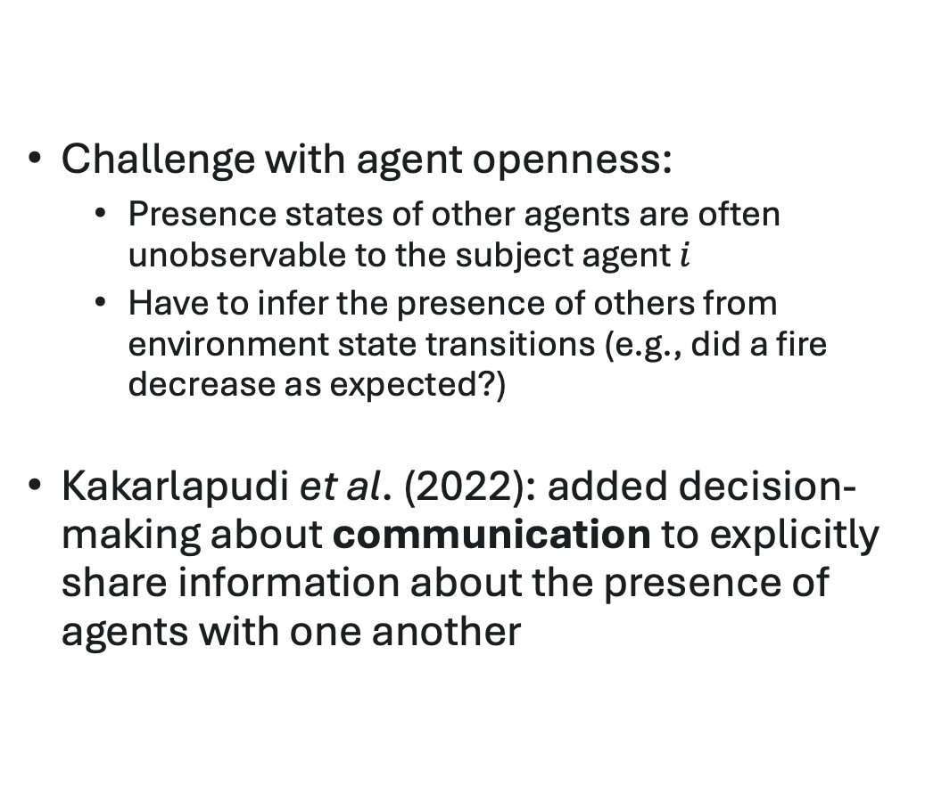
Modeling Agent Openness (Communication)
Challenge with agent openness:
Presence states of other agents are often unobservable to the subject agent $i$
Have to infer the presence of others from environment state transitions (e.g., did a fire decrease as expected?)
Kakarlapudi et al. (2022): added decision-making about communication to explicitly share information about the presence of agents with one another

Slide 64
Modeling Agent Openness (Communication)
Agents treat messages from other agents as explicit observations about their presence states
Incorporate into the belief update about the presence states of neighbors
Do not necessarily fully trust the shared information (e.g., could be a faulty information channel)

Slide 65
Modeling Agent Openness (Communication)
Assume a self-interested decision process, so agents do not share every time step
Instead, decide when and how to communicate in order to influence neighbors to accomplish own goals
Also consider costs of communication (e.g., energy usage, channel bandwidth)
Double decision process -- how to act and how to communicate, all within one planning process

Slide 66
Modeling Agent Openness (Communication)
Developed a fully online planning algorithm (CI-POMCP-PF)
Does not require pre-computed policies for neighbors (Eck et al., 2020) but instead plans each neighbor’s behavior in real-time
Can be used with no prior knowledge of other agents needed!
Agents decide how to communicate by simulating how they expect those messages to influence other agents’ future decisions
Also addresses the exponential size of the observation space due to the inclusion of messages
First online algorithm for the CI-POMDP (Gmytrasiewicz, 2020)

Slide 67
Modeling Agent Openness (Graph-based Learning)
All of the approaches so far have been planning-based
Require at least a model of environment dynamics to be known in advance
Often also the set of all agents that might be in the environment
Rahman et al. (2021): developed the first deep RL solution for decision making with agent openness
Specifically address ad hoc teamwork (Stone et al., 2010) where agents do not coordinate with peers in advance

Slide 68
Modeling Agent Openness (Graph-based Learning)
Agent Openness:
Agents can enter or leave the system at any time
Team composition is not fixed
Type Openness:
Each agent may have different internal behavior (policy/type)
Learner has no prior access to teammate policies
Teammates may change type over time

Slide 69
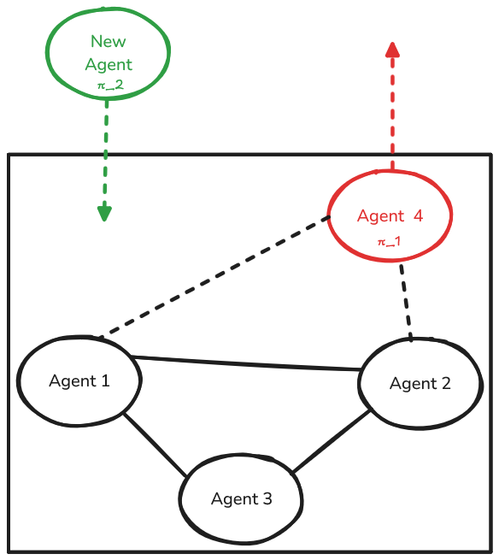
Modeling Agent Openness (Graph-based Learning)
Modeled agent openness using dynamic interaction graphs
Nodes are agents currently in the system
Edges represent relationships between agents for the current task
Interaction graphs change over time as agents join and leave the system
Graph structure can change from one step to the next if inputted into Graph Neural Networks (GNNs)
Use convolution operations to learn over subgraphs
Solution called Graph-based Policy Learning (GPL)

Slide 70
Modeling Agent Openness (Graph-based Learning)
Can also infer types of other agents through recurrent layers
Long-short term memory (LSTM) layers learn from sequences of observed behaviors of each neighbor
Initial study assumed agent types were static, but could be used as the basis of a solution for addressing type openness

Slide 71
Modeling Agent Openness (Graph-based Learning)
Rahman et al. (2023) extended GPL to partially observable environments (PO-GPL)
Adds beliefs about:
environment states
unobserved agents to better model joint actions
Compared multiple approaches for addressing partial observability
Encoder-decoder layers (e.g., VAE)
Sequential Monte Carlo estimation

Slide 72
Exercise 3
What strengths and weaknesses do you see with each of the methods discussed?
In terms of approximation quality, tractability, complexity of environment, etc.?

Slide 73
Outline
Topic 1: Introduction to Open Agent Systems [45 min]
Types and Sources of Openness
Challenges caused by Openness
Example Applications
Topic 2: Multiagent Reasoning in OASYS [50 min]
Origins of OASYS
Background: (Multiagent) Markov Decision Processes
Planning and Reinforcement Learning Solutions
Topic 3: Emerging and Future Research in OASYS [45 min]
Addressing scalability to many-agent systems
Focusing on Task and Type Openness
Human-AI Interactions
Topic 4: MOASEI Competition and Community Discussion [20 min]

Slide 74
Scalability to Many-Agent Systems
Most planning and reinforcement learning solutions work with a small number of agents (e.g., 2-10)
Joint action space is exponential in the number of agents
Agent openness adds curse of dimensionality to presence state/coalition modeling
Real-world applications often involve hundreds, thousands, or more agents
Solutions must address scalability to be of practical use

Slide 75
Exercise 4
What are some possible approaches to reasoning about openness that could scale to many-agent environments?
To handle agent openness?
To handle task openness?
To handle type openness?

Slide 76
Scalability to Many-Agent Systems
Extrapolation method of Eck et al. (2020) scales to 50+ agents, but unknown how much farther it can go
In progress: exploring approaches from mean-field reinforcement learning to scale to thousands of agents
Learn an average behavior of the rest of the system, use to infer joint actions
Could also learn average presence of rest of the agents for agent openness
Maybe average type of the rest of the agents for type openness?

Slide 77
Focusing on Task Openness
Almost all research on decision-making in OASYS has focused on solely on agent openness
How to address task openness is generally an open question
Especially task openness with exogeneous causes that are not known in advance and cannot be modeled

Slide 78
Exercise 5
What are some possible approaches to reasoning about task openness?
From the planning literature?
From the reinforcement learning literature?
From the game theory literature?
From other approaches to decision-making?

Slide 79
Focusing on Task Openness
In progress: deep reinforcement learning solution called Models of Hyper-Interactions under Task Openness (MOHITO)
Just accepted at UAI’2025
Extend the graph-based modeling ideas of GPL to also represent task features and relationships between agents/tasks/actions
Graph structure can change from one time step to the next to include newly appearing tasks and remove disappearing tasks

Slide 80
Focusing on Task Openness

Slide 81
Focusing on Task Openness

Slide 82
Exercise 6
What are some possible approaches to reasoning about type openness?
From the planning literature?
From the reinforcement learning literature?
From the game theory literature?
From other approaches to decision-making?

Slide 83
Human-AI Interactions
The presences of humans as agents often creates an OASYS:
Agent openness: humans join and leave systems for a variety of reasons
Task openness: people often have simultaneous tasks from outside the system
Type openness: humans change roles frequently
Properly reasoning about longitudinal Human-AI interactions requires OASYS-based solutions

Slide 84
Exercise 7
What are some specific ways that humans-in-the-loop create OASYS?
Agent openness?
Task openness?
Type openness?

Slide 85
Outline
Topic 1: Introduction to Open Agent Systems [45 min]
Types and Sources of Openness
Challenges caused by Openness
Example Applications
Topic 2: Multiagent Reasoning in OASYS [50 min]
Origins of OASYS
Background: (Multiagent) Markov Decision Processes
Planning and Reinforcement Learning Solutions
Topic 3: Emerging and Future Research in OASYS [45 min]
Addressing scalability to many-agent systems
Focusing on Task and Type Openness
Human-AI Interactions
Topic 4: MOASEI Competition and Community Discussion [20 min]

Slide 86
MOASEI Competition
New competition series @ AAMAS
Meeting: This afternoon in Joliet A!
Goal: encourage more participation in studying OASYS within multiagent systems
Explore strengths and weaknesses of reinforcement learning and planning solutions in OASYS

Slide 87
MOASEI Competition
Three tracks:
Track 1: Agent openness in Cybersecurity Defense
Track 2: Task openness in Dynamic Ridesharing
Track 3: Agent & Task openness in Wildfire Suppression
Website: https://oasys-mas.github.io/moasei.html
Software: https://github.com/oasys-mas/free-range-zoo

Slide 88
Community Discussion
What opportunities do you see in studying OASYS?
What are some challenges that we did not discuss today?

Slide 89
Contact Information
Leen-Kiat Soh: lksoh@unl.edu
Adam Eck: aeck@oberlin.edu

Slide 90
References
Bellman, R. 1957. “A Markovian Decision Process.” Indiana University Mathematics Journal 6: 679–684.
Bernstein, D. S., R. Givan, N. Immerman, and S. Zilberstein. 2002. “The Complexity of Decentralized Control of Markov Decision Processes.” Mathematics of Operations Research 27(4): 819–840.
Calmet, J., A. Daemi, R. Endsuleit, and T. Mie. 2004. “A Liberal Approach to Openness in Societies of Agents.” In Engineering Societies in the Agents World IV, Lecture Notes in Computer Science, volume 3071, 81–92. Berlin: Springer.
Chandrasekaran, M., A. Eck, P. Doshi, and L. Soh. 2016. “Individual Planning in Open and Typed Agent Systems.” In Proceedings of the Thirty-Second Conference on Uncertainty in Artificial Intelligence, UAI'16, 82–91. Arlington, Virginia, USA: AUAI Press.
Chen, B., X. Chen, A. Timsina, and L.-K. Soh. 2015. “Considering Agent and Task Openness in Ad Hoc Team Formation (Extended Abstract).” In International Conference on Autonomous Agents and Multiagent Systems (AAMAS), 1861–1862.
Chen, B., A. Eck, and L.-K. Soh. 2016. “Collaborative Human Task Assignment for Open Systems (Extended Abstract)”. In Proceedings of the 15th International Conference on Autonomous Agents and Multiagent Systems (AAMAS’16), Thangarajah, Tuyls, Jonker, and Marsella (eds.), Singapore, May 9-13, 2016.
Cohen, J., J.-S. Dibangoye, and A.-I. Mouaddib. 2017. “Open Decentralized POMDPs.” In 2017 IEEE 29th International Conference on Tools with Artificial Intelligence (ICTAI), 977–984.
Eck, A., M. Shah, P. Doshi, and L. Soh. 2020. “Scalable Decision-Theoretic Planning in Open and Typed Multiagent Systems.” In Proceedings of the Thirty-Fourth AAAI Conference on Artificial Intelligence, AAAI’20.
Eck, A., L-K. Soh, & P. Doshi. 2023. Decision making in open agent systems. AI Magazine. 44(4): 508-523.
Gmytrasiewicz, P. J., and P. Doshi. 2005. “A Framework for Sequential Planning in Multiagent Settings.” Journal of Artificial Intelligence Research 24: 49–79.
Gmytrasiewicz, P. 2020. “How to do Things with Words: A Bayesian Approach.” Journal of Artificial Intelligence Research 68: 753–776.
Hoang, T. N., and K. H. Low. 2013. “Interactive POMDP Lite: Towards Practical Planning to Predict and Exploit Intentions for Interacting with Self-Interested Agents.” In 23rd International Joint Conference on AI (IJCAI).
Huynh, T. D., N. R. Jennings, and N. R. Shadbolt. 2006. “An Integrated Trust and Reputation Model for Open Multi-Agent Systems.” Autonomous Agents and Multi-Agent Systems 13(2): 119–154.
Jamroga, W., A. Meski, and M. Szreter. 2013. “Modularity and Openness in Modeling Multi-Agent Systems.” In Fourth International Symposium and Games, Automata, Logics and Formal Verification (GandALF), 224–239.
Jumadinova, J., P. Dasgupta, and L.-K. Soh. 2014. “Strategic Capability-Learning for Improved Multi-Agent Collaboration in Ad-Hoc Environments.” IEEE Transactions on Systems, Man, and Cybernetics-Part A 44(8): 1003–1014.
Kakarlapudi, A., G. Anil, A. Eck, P. Doshi, and L.-K. Soh. 2022. “Decision-Theoretic Planning with Communication in Open Multiagent Systems.” In Proceedings of the Thirty-Eighth Conference on Uncertainty in Artificial Intelligence, 938–948.
Pineau, J., G. Gordon, and S. Thrun. 2003. Point-based value iteration: An anytime algorithm for POMDPs. In Proceedings of IJCAI’03, pp. 1025–1032.
Pinyol, I., and J. Sabater-Mir. 2011. “Computational Trust and Reputation Models for Open Multi-Agent Systems: A Review.” Artificial Intelligence Review 40: 1–25.
Rahman, A. et al. 2021. "Towards open ad hoc teamwork using graph-based policy learning." International conference on machine learning. PMLR.
Rahman, A. et al. 2023. "A general learning framework for open ad hoc teamwork using graph-based policy learning." Journal of Machine Learning Research, 24(298): 1-74.
Ross, S., B. Chaib-draa, and J. Pineau. 2007. “Bayes-Adaptive POMDPs.” In Neural Information Processing Systems (NIPS).
Shehory, O. 2000. “Software Architecture Attributes of Multi-Agent Systems.” In 1st International Workshop on Agent-Oriented Software Engineering, Revised papers, 77–89. ACM.
Silver, D., and J. Veness. 2010. “Monte-Carlo Planning in Large Pomdps.” In 23rd International Conference on Neural Information Processing Systems (NIPS), NIPS'10, 2164–2172.
Stone, P., G. A. Kaminka, S. Kraus, and J. S. Rosenschein. 2010. “Ad Hoc Autonomous Agent Teams: Collaboration without Pre-Coordination.” In Proceedings of the Twenty-Fourth AAAI Conference on Artificial Intelligence, AAAI'10, 1504–1509.

